Slide 1
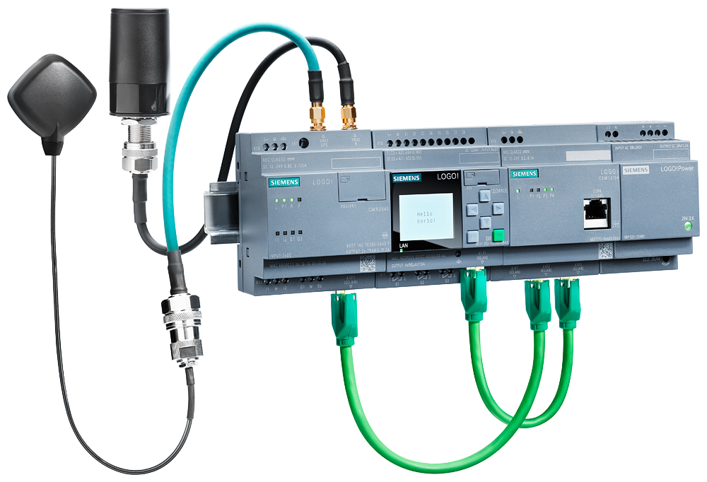
LOGO! Communication Modules
Remote control and monitoring with LOGO!
Technical slides
February 2020
siemens.com/logo
Unrestricted © Siemens 2020

Slide 2
Agenda
1
Positioning
2
Technology / portfolio
3
Benefits
4
Use Cases
5
Technical Details
6
Order information and logistic
7
Target customers
8
Support

Slide 3



LOGO!
Modular PLC – positioning
  LOGO! – for simple automation tasks
  LOGO! – mainly for stand alone applications
  LOGO! – offers ready to use function blocks for various applications, other than in controllers where these functions must be programmed explicitly
  LOGO! – fits into the standard cabinets for building applications and is certified for domestic areas (limit Class B Group 1)
SIMATIC S7-1500
The modular controller for system solutions in mid-range to high-end discrete automation
Advanced
SIMATIC S7-1200
The modular compact controller for solutions in basic discrete and standalone automation
Basic
Application complexity
Micro
LOGO!
Logic module for switching and controlling solutions in small-scale automation projects
Nano
Resource power I/O capacity, program size, instruction speed, communication capabilities …

Slide 4
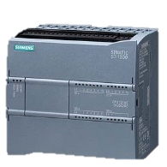
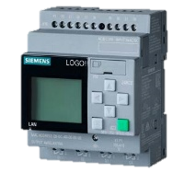

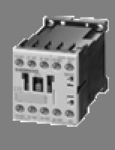
LOGO! – The ideal solution in between auxiliary relays and controllers
  LOGO! closes the gap between relays, auxiliary contactors, timers and the world of controllers
  LOGO! means connecting functions logically by mouse-click instead of wiring
  LOGO! is the perfect introduction into the world of automation just below the world of controllers
Price
SIMATIC
S7-1200 PLC
LOGO!
Logic module
Time relay
Auxiliary contact
Functionality

Slide 5
Agenda
1
Positioning
2
Technology / portfolio
3
Benefits
4
Use Cases
5
Technical Details
6
Order information and logistic
7
Target customers
8
Support

Slide 6
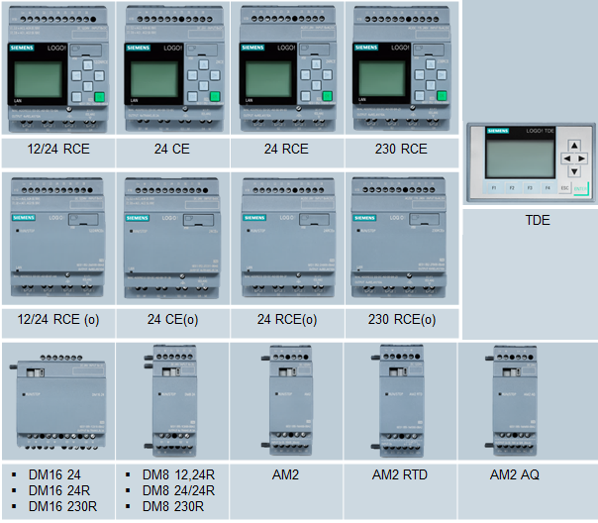
LOGO! product overview
4 basic modules with and without display, all with
Ethernet interface
8 inputs 4 outputs, expandable
up to max.: 24 DI, 20 DO, 8AI und 8 AO
Modules for different Voltages
  12/24 V DC, relays-outputs 10A, 4 inputs as 0-10V AI useable
  24 V DC, transistor-outputs, 4 inputs as 0-10V AI useable
  24 V AC DC, relays-outputs 10 A
  115 -240 V ACDC, relays-outputs 10A
LOGO! expansion modules
  Digital: DM8 with 4 DI/4 DO; DM 16 with 8 DI/8 DO (diverse voltages)
  Analog: AM2 with 2 analog inputs 0-10V,0/4-20mA
  AM2 RTD with2 analog inputs for PT 100 / PT1000
  AM2 AQ with 2 analog outputs 0-10V,0/4-20mA
LOGO! TDE
  6 lines, each 20 characters
  3 switchable background colors to highlight different kinds of messages
  2 Ethernet-Interfaces
  4 function keys

Slide 7
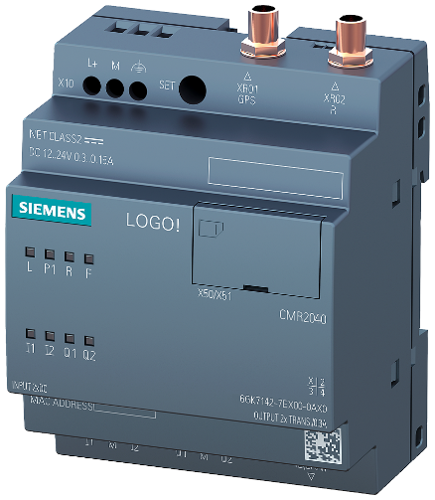
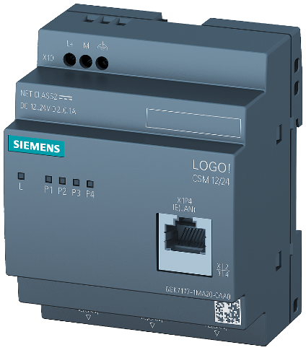
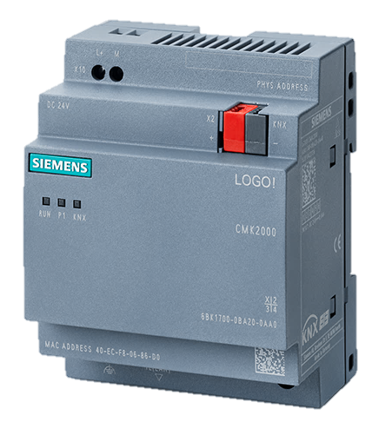
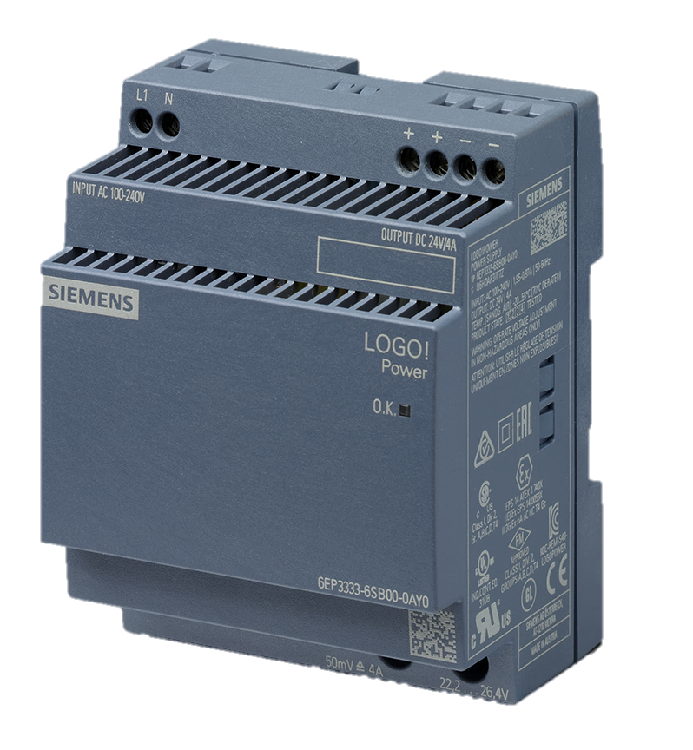
LOGO! additional components
LOGO! CMR 2020 / 2040
communication module
for GSM und GPS
Remote access on LOGO! 8 via SMS (sending/receiving)
Symbolic names (Alias) for SMS
Send e-mails
Remote programming via
open VPN
Position determination via GPS, e.g. for container tracking
Time synchronization
Programming via web browser
LOGO! CSM
Switch with 4 ports
One port at the front for direct access inside control cabinets
+
+
LOGO! Power
4 versions for 24 V
0,6 A; 1,3 A; 2,5 A and 4 A
3 versions for 12 V
0,9 A; 1,9 A and 4,5 A
+
LOGO! CMK2000
Communication module for
integration into KNX building bus systems
Communication between LOGO! and KNX actuators/ sensors
Programming via KNX Software ETS
+

Slide 8
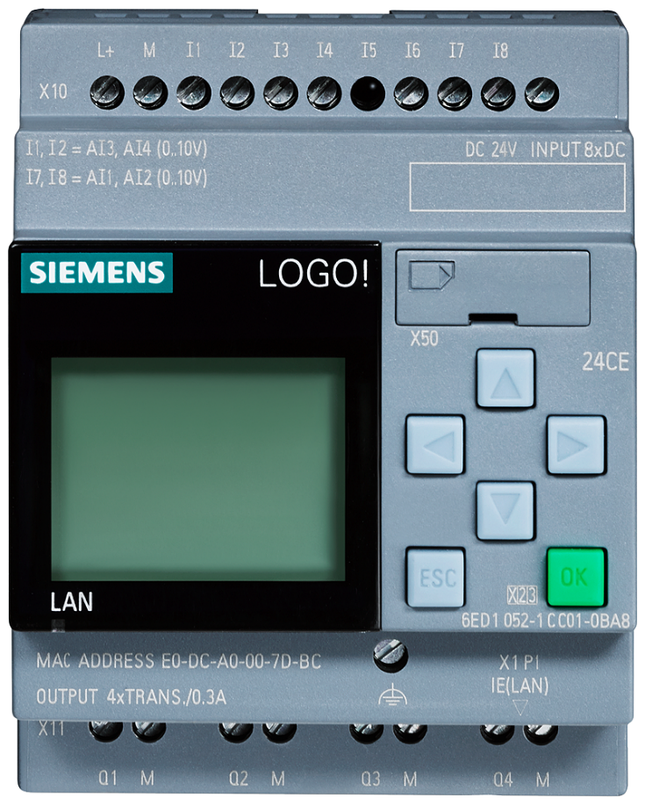
LOGO! highlights
This is LOGO!
All LOGO! devices
include communication via Ethernet
LOGO! ⬄ LOGO!
LOGO! ⬄ HMI
LOGO! ⬄ S7-Controller
LOGO! ⬄ Modbus TCP/IP
LOGO! => PC (Access Tool)
Time synchronization
LOGO! Soft Comfort V8.2
Single and network mode
Programming Communication via drag & drop
Programming of Modbus communication and time
synchronization
+
+
Integrated webserver
Design websites with own images and icons – without HTML
No HTML knowledge necessary
Or view like message text and TDE
View like LOGO! or
LOGO! TDE with use of function keys
+
Display
6 lines each 16 characters
3 background colors
LOGO! text display
6 lines each 20 characters
3 background colors
2 Ethernet connections
4 function keys
+
Micro SD-Card slot
Easy uploading and downloading of programs to the LOGO!
Usable for data-logging
Know-How protection
+
Temperature range
-20 °C to 55 °C

Slide 9
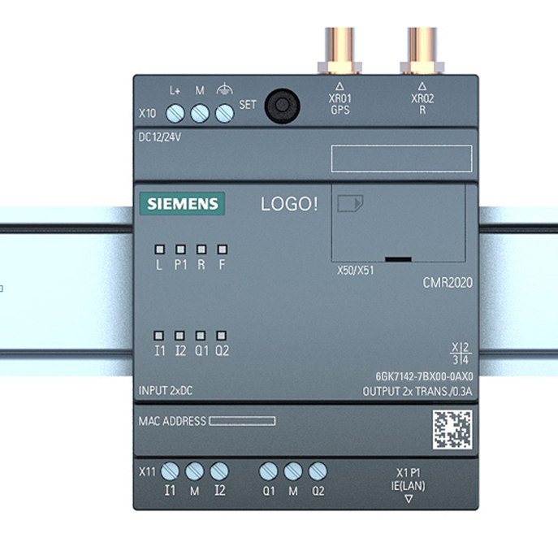
LOGO! CMR highlights
Monitoring, alerting and control of distributed systems via SMS and /
or e-mail
Simple diagnosis using LED
  Supply voltage
  LAN status
  Signal strength (mobile wireless)
  Status LED for DI and DO
+
+
Use of an intuitive, easy-to-remember SMS Syntax
+
Configuration via
Web Interface
Time synchronization of
LOGO! using
  GPS
  GRPS (NTP)
  Mobile radio network provider
+
+
Mounting Options:
  35mm DIN rail
  (DIN EN 50022)
  Wall mounting
+
Position detection using
GPS-signal
+
Remote Access via OpenVPN
and HTTP to LOGO! CMR und LOGO! Basic Module
+
Stand alone functionality
with 2 DI and 2 DO
+

Slide 10
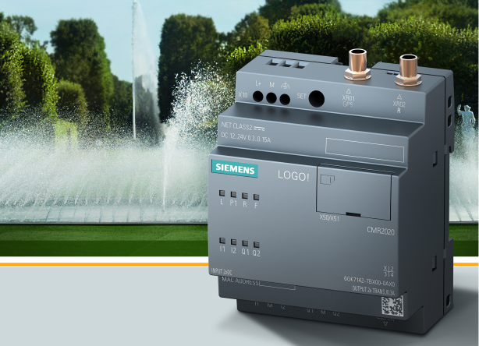

LOGO! CMR
Functions
Remote Communication via mobile wireless networks
(CMR2020 GSM/GPRS; CMR2040 LTE, UMTS)
  Reading/writing of data from/to the LOGO! basic units using intuitive* SMS
  Event-driven alerting using SMS and /or e-mail*
  Simple switch processes via digital integrated IOs: Reading the inputs and switching of the outputs of the LOGO! CMR
Secure Remote Access* via mobile wireless networks to
  LOGO! CMR ( Web Interface via OpenVPN/HTTP)
LOGO! Basic Module via OpenVPN and http with Web server or LOGO! App for
Up-/Download of the LOGO! SoftComfort programs).
Time-of-day synchronization
  The time of the LOGO! basic unit can be set by transferring the received time from LOGO! CMR
  by UTC-Time of an accessible NTP-Server
  Time of the GPS-Signal or the cellular network providers
Position detection of the LOGO! CMR per GPS signal
  Forward of the position data in the LOGO! Logic Module and query via SMS
Remote control, monitoring and programming for LOGO!

Slide 11
LOGO! CMR
Further functions with firmware V2.0
Using a DynDNS-Dienst, to reach the LOGO! CMR via Host-Name, e.g. "myName.dyndns.org„ (DynDNS or noip)
Extensions of the SMS-Syntax
  Write/Read single Bits
  Alias SMS
  Using of configured signal names also in SMS-Syntax
  SMS password optional
Optional using of a simple Web Interface Password
Further Improvements:
  Test SMS / e-mail for IBS
  Monitoring of GPS-Position on Web Interface
  Further Diagnostic Informations (Counter for SMS/e-mail successful/lost send/received)
  Timesynchronization out of actualisation interval
  Acknowledgement of incoming SMS
  Default Router for LAN-Interface
Further functions with firmware V2.0

Slide 12
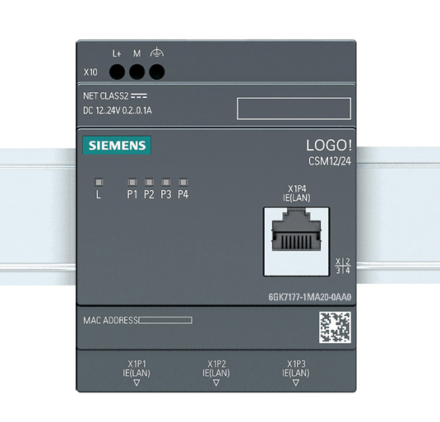
LOGO! CSM
Highlights
Unmanaged Industrial
Ethernet Switch
  4x RJ45 Ports
  10/100 Mbit/s
  Auto negotiation and auto crossing
LOGO! 8 Design
  Switch for junction box with
  one RJ45-Port on the front
  Ideal for use with LOGO!
  Stand-alone application
+
+
Simple diagnosis using LED
  Supply voltage
  Link status and transfer of data per port
Terminal block for
  Power supply
+
+
Mounting Options:
  35mm DIN rail
  (DIN EN 50022)
  Wall mounting
+
+

Slide 13
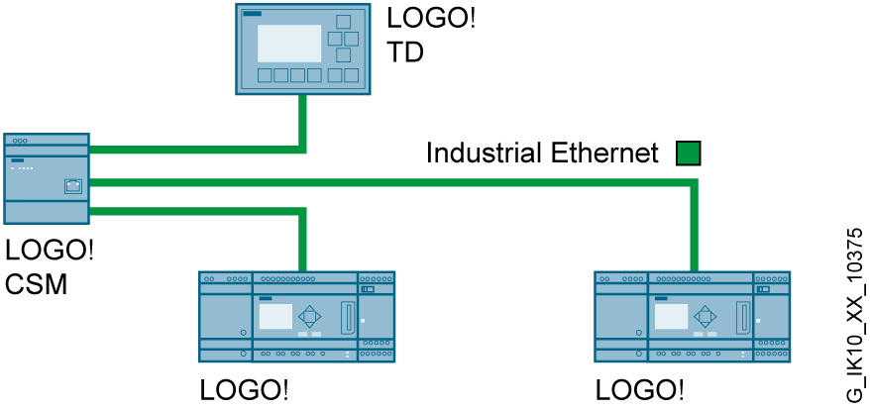
LOGO! CSM unmanaged Compact Switch Module
Functional overview
  Industrial Ethernet Switch in the form factor of LOGO! with 4 electrical RJ45 ports 10/100 Mbit/s with auto crossing and auto negotiation
  Low-cost setup of small machine networks
  Fast commissioning without configuration
  Simple local diagnostics via LEDs
Ideal for Networking of small systems with LOGO! or SIMATIC S7
Notes:
Notizen 13

Slide 14
Agenda
1
Positioning
2
Technology / portfolio
3
Benefits
4
Use Cases
5
Technical Details
6
Order information and logistic
7
Target customers
8
Support

Slide 15
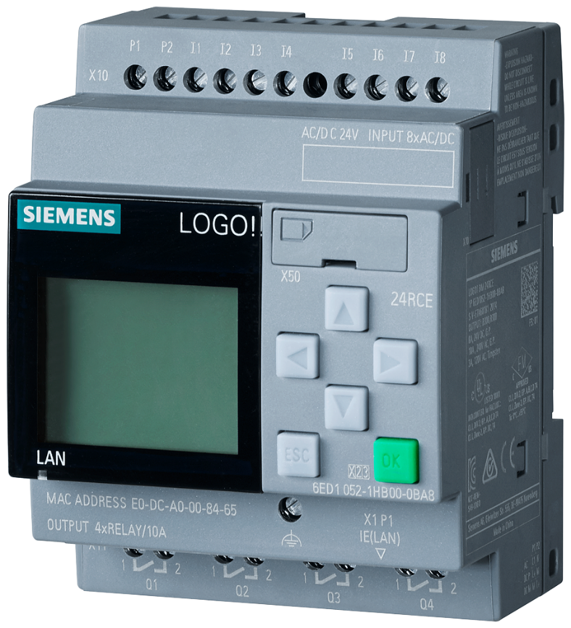
LOGO!
Benefits
Features/ functions |  | Benefit
8 basic modules with Ethernet and integrated Webserver | ◆ | Communication with all S7-Systems Remote control and monitoring Insert your own pictures and symbols
Extended temperature range for basic and expansion modules -20° to +55°C | ◆ | Cost efficient solution for use at low temperatures
NTP server/client for date and time synchronization | ◆ | All LOGO! devices in a network show the same time
Integrated Modbus TCP/IP protocol as client and server | ◆ | Simple communication to third parts devices via Ethernet
LOGO! Access Tool as excel add-in to read and archive process data LOGO! Web editor | ◆ | Process values can be analyzed, archived and visualized in Excel while the process is running

Slide 16
LOGO! CMR
Benefits
Features / Functions |  | Benefit
Read/write data/variables from/to LOGO! 8 basic unit using SMS and e-mail | ◆ | Low-cost and easy-to-use alarm messaging system
Secure remote access to LOGO! CMR and LOGO! BM | ◆ | Low-cost remote access via SMS for operating and controlling the LOGO! logic module
Time-of-day synchronization via NTP server, GPS signal or mobile network provider and forwarding to LOGO! basic unit | ◆ | Simple realization of time-controlled control tasks with Logikmodul LOGO!
Position detection of the LOGO! CMR per GPS signal and query option per SMS | ◆ | Position detection e.g. Container in logistics applications

Slide 17
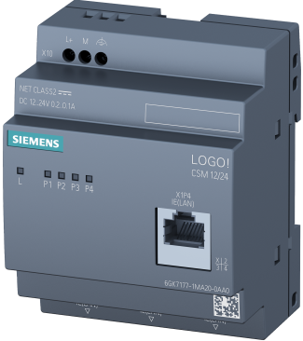
LOGO! CSM12/24
Benefits
Feature / Function |  | Benefit
For connecting a LOGO! and up to three other nodes to an Industrial Ethernet network | ◆ | Implementation of low-cost Industrial Ethernet networks for connecting LOGO! basic units
1 RJ45 Port at front side | ◆ | Freely accessible Ethernet port on front side for direct diagnostics access when installing in a cabinet
Design of LOGO! | ◆ | Industrial design of the new LOGO! generation Space-saving installation for connection to LOGO! 8 optimized

Slide 18
Agenda
1
Positioning
2
Technology / portfolio
3
Benefits
4
Use Cases
5
Technical Details
6
Order information and logistic
7
Target customers
8
Support

Slide 19
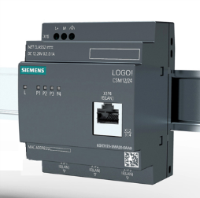
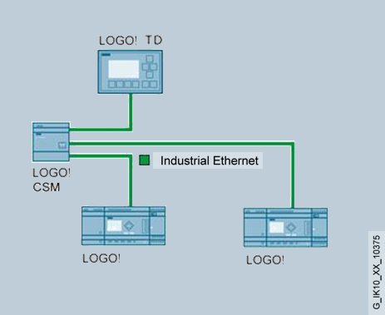
Networking with LOGO! CSM12/24
Task
Networking of small systems with LOGO! or SIMATIC
Solution
With the LOGO! CSM12/24 in the form factor of LOGO! 8, up to 4 Ethernet devices with 10/100 Mbit/s can be connected. As an unmanaged Ethernet Switch with 4 electrical RJ45 ports 10/100 Mbit/s with auto crossing and auto negotiation, the CSM requires no commissioning
Benefit
Low-cost setup of small machine networks
Fast commissioning without configuration
Simple local diagnostics via LEDs
Networking with LOGO! CSM12/24

Slide 20
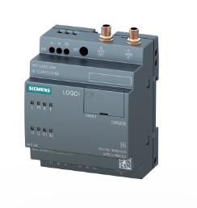
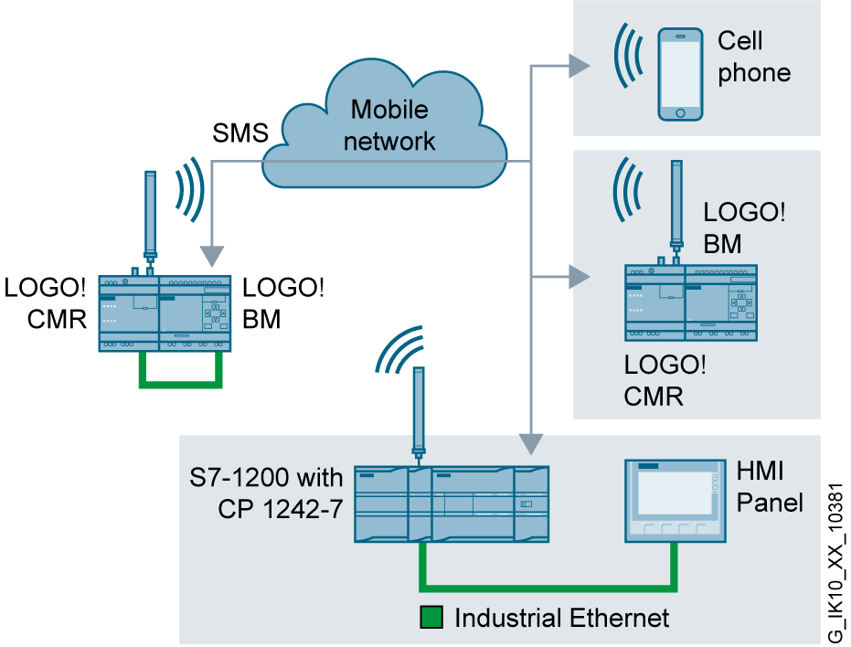
Monitoring, alerting and control of distributed systems using SMS, e.g. monitoring of a water tank with LOGO! CMR
Task
Note:
Example: Syntax of received SMS Password;LOGO=VM125,1,BYTE
Remote monitoring of the level of a water tank, and control via an outlet valve
Solution
The LOGO! CMR monitors the process image of the defined signals of the LOGO! basic unit.
If a defined event occurs, such as the setting of an input, a text message is sent to a defined group of mobile telephone numbers.
Conversely, the CMR can receive a text message and transfer appropriate values to the LOGO! which can then respond according to these values.
Benefit
Low-cost solution for simple remote stations based on the LOGO! logic module
Monitoring, Alerting and Control of Distributed Systems using SMS, e.g. Level Monitoring of a Water Tank with LOGO! CMR

Slide 21

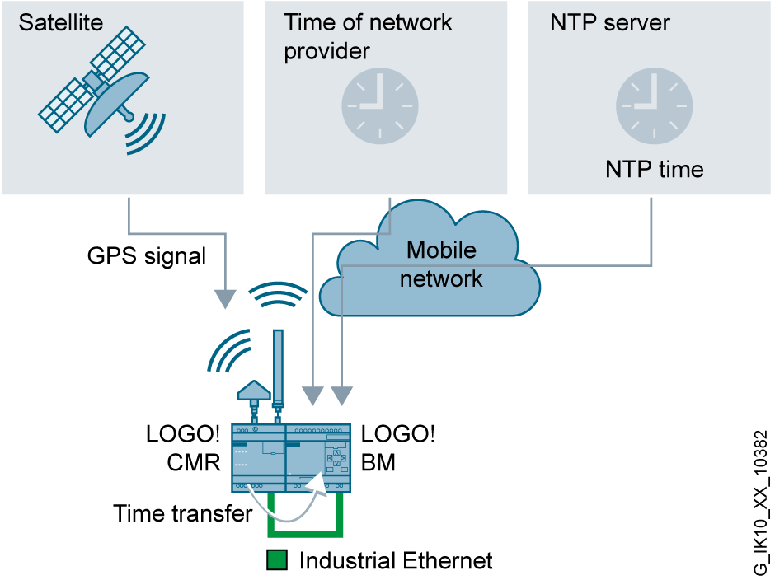
Time-of-day synchronization using LOGO! CMR by means of NTP, Mobile Network Provider or GPS
Task
Use of the LOGO! as the control unit for church tower clocks or school clocks, e.g. sending signals for break time, or controlling church bells. Regular time synchronization is required in this case.
Note:
There is no mobile wireless communication needed for Time-of-day synchronization
Solution
The CMR enables automatic time synchronization of the LOGO! using different procedures
Forwarding of the time-of-day of the mobile network provider
LOGO! CMR calculates the time-of-day for the NTP server to be defined on the Internet
LOGO! CMR receives the UTC time by satellite via GPS
Benefit
Easily parameterized solution for synchronizing the LOGO! with a local time-of-day (including summer/winter time adjustment
Time-of-day synchronization using LOGO! CMR by means of NTP, Mobile Network Provider or GPS

Slide 22
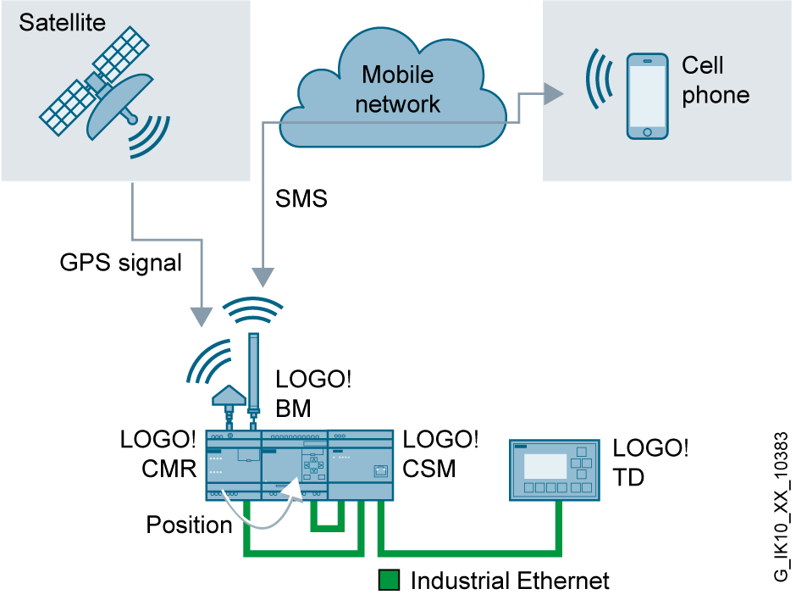
LOGO! CMR calculation of position data by means of GPS
Task
Note:
Example: Syntax of received SMS to get the GPS-position: GPSPOSITION?
Response SMS:
GPS-Position: 49:0:50.4 N 8:24:15.48 E Alt 0350
Continuous recording of the position data of a container, for example, and querying of the data if required.
Solution
The LOGO! CMR calculates the position from the GPS signal received via GPS antenna from the satellite and triggers an appropriate configured action.
The determined position e.g. will be sent per SMS by the LOGO! CMR or will be sent to the LOGO! BM. In the LOGO! BM the GPS-Signal can be logged and, if necessary be queried via the LOGO! CMR.
Benefit
Low-cost solution for position detection by GPS signal via query option using text messages
LOGO! CMR Calculation of Position Data by means of GPS

Slide 23
LOGO! CMR
Symbolic addressing / Alias SMS
Task
Example-SMS for request the level:
Stufe1: LOGO?VM125,Word
Stufe2 - symbolisch: LOGO?Level1
Stufe2 - Alias: Level1
Example-SMS to set the max. level:
Stufe 1: Hugo;LOGO=VM127,40,WORD
Stufe 2 – symbolisch: Hugo;LOGO=levellmax,40
Stufe 2 – Alias: levelmax
Remote Monitoring and Control of the level of a water tank
Solution
The LOGO! CMR monitors the process image of the defined signals of the LOGO! basic module
If a defined event (e.g. setting an input), a SMS to a defined group of mobile phone numbers (user) is sent
The level could also be requested by a defined user.
The user should be able to send the permitted level value via SMS to CMR. This transfer the value to the LOGO! BM.
For SMS-Syntax, the user can use the symbolic addressing or the Alias SMS
Benefit
Simple usability – the user must not longer work with complicated SMS-Syntax. He can easily put together useable commands
Symbolic addressing / Alias SMS

Slide 24
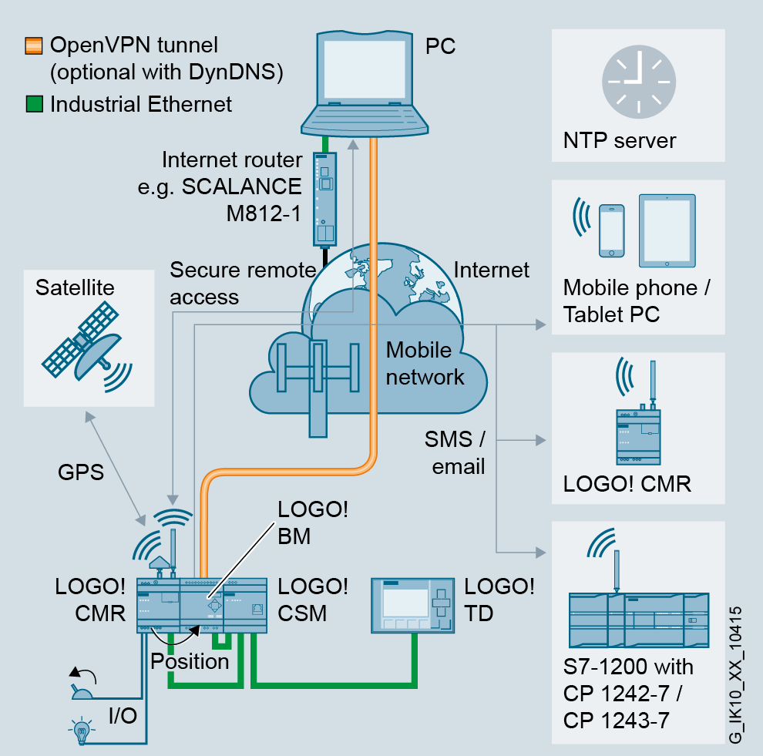
Secure remote access to LOGO! CMR and LOGO! BM
Task
LOGO! CMR and LOGO! BM should be configurable via Smartphones / Tablet.
Solution
From a remote station (Smartphone/ Tablet), you can call the Web Interface of the LOGO! CMR via OpenVPN and http to change settings.
At the same time you can call the Web Interface of the LOGO! BM which is connected to the LOGO! CMR via OpenVPN.
It is also possible to download a LSC-Project via this OpenVPN Tunnel to the LOGO! BM
You can also start the LOGO! App via this tunnel.
Benefit
Reduction of travel costs, allowing remote access to configuration and diagnostics over the mobile wireless network.
Secure Remote Access to LOGO! CMR and LOGO! BM

Slide 25
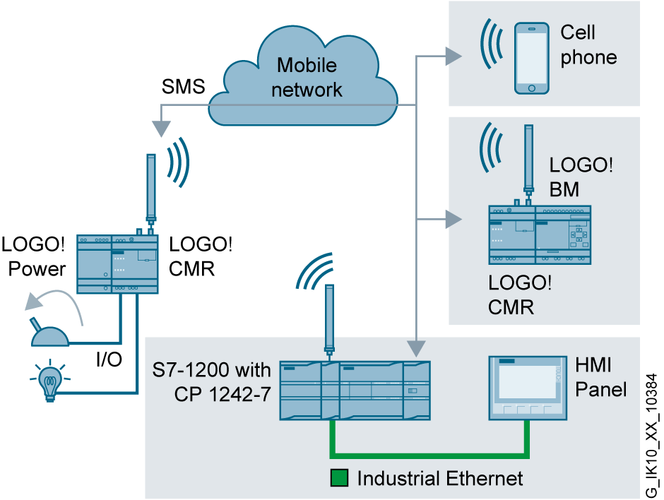
Examples of stand-alone applications for LOGO! CMR
Task
Note:
Example: Syntax of a received SMS to set an internal digital Output: Password;OUTPUT=O1,1
Remote control of switching operations, e.g. for light control in a poorly accessible hall.
Solution
The LOGO CMR enables direct connection of actuators, e.g. for light control via 2 integral digital outputs with control via SMS.
Sensors can be connected via the additional 2 integral digital inputs, e.g. for monitoring the current status, and likewise read out by means of SMS text messages.
Benefit
Low-cost solution for remote control of digital sensors and actuators.
Examples of stand-alone applications for LOGO! CMR

Slide 26
Agenda
1
Positioning
2
Technology / portfolio
3
Benefits
4
Use Cases
5
Technical Details
6
Order information and logistic
7
Target customers
8
Support

Slide 27
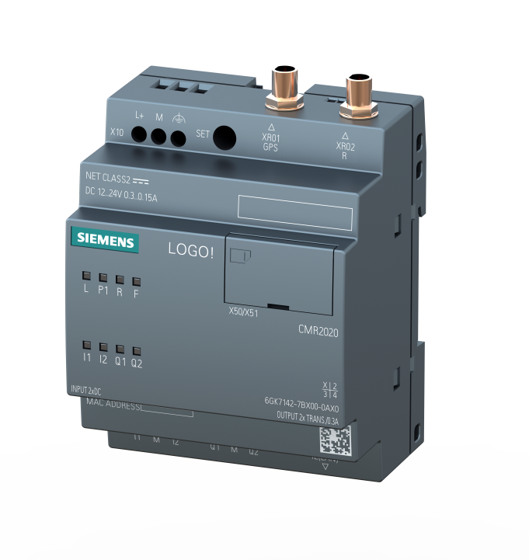
LOGO! CMR
Design
Recessed SET button for resetting to factory setting
SMA socket for GPS antenna
Terminal sockets for power supply
SMA socket for mobile wireless antenna
Card slot behind cover for:
  Micro SD cards
  SIM cards
Diagnostics LEDs for
Supply voltage
Link status on the LAN
Reception’s quality of the mobile wireless signal
Fault
Mounting options:
  Mounting rails (35 mm according to
  DIN EN 50022)
  Wall mounting
Status LEDs for inputs and outputs
Connection to LOGO! 8
  Industrial Ethernet RJ45
  100 Mbit/s with Autosensing and auto crossover function
Terminal sockets for digital input and output signals

Slide 28
LOGO! CMR
Technical data
 | LOGO! CMR2020 | LOGO! CMR2040
Housing | 4TE (72 mm)
Programming interface | Industrial Ethernet (RJ45) or mobile wireless
Memory card for mobile wireless | SIM cards or Micro SD card
Connection for mobile wireless antenna | SMA socket (50 ohms)
Supported mobile wireless networks/services | GSM / GPRS | GSM / LTE
Connection for GPS antenna | SMA socket (50 ohms)
Inputs/outputs (DI / DO) | 2 / 2 (on terminal block)
External power supply | 24 V DC (on terminal block)
Industrial Ethernet | 1 x RJ45 (10/100 Mbit/s)
Temperature range in operation | -20°C … +70°C
Degree of protection | IP20
Mounting method | Standard mounting rail or wall mounting

Slide 29
LOGO! CMR
Key data / Quantities
 | LOGO! CMR
Default Login / Password | admin/ admin
Default IP-Address | 192.168.0.3
Subnet mask | 255.255.255.0
Maximum definable user/ phone numbers | 20
Maximum definable user groups | 10
Maximum definable signals, which can be monitored | 32
Maximum definable events, which can be occur | 32
Maximum definable actions, which can be triggered | 32
Maximum definable associations between events and actions | 32

Slide 30
LOGO! CMR function: SMS receive
Syntax overview of the possible SMS, which can be received
Read information from CMR | Example Syntax SMS command
Read diagnostic data from CMR | DIAG?
Read GPS-Position from CMR | GPSPOSITION?
Read process image | MONITOR?
Read status of the LOGO! BM | STATUS?
Read current value | LOGO?VM125,WORD
Influence data in CMR/LOGO! BM | Example Syntax SMS command
Change Status of LOGO! BM | Password;STATUS=RUN
Write current value | Password;LOGO=VM125,1,WORD
Set Digital Output of CMR | Password;OUTPUT=O1,1
Change phone number of one user | Password;CHANGEUSER=„Joe“;“01721234567“
Configure address of NTP-Server | Password;NTPSERVER= "217.13.75.19"
Request to cellular network provider via service code | Password;SERVICECODE=„*100#“

Slide 31
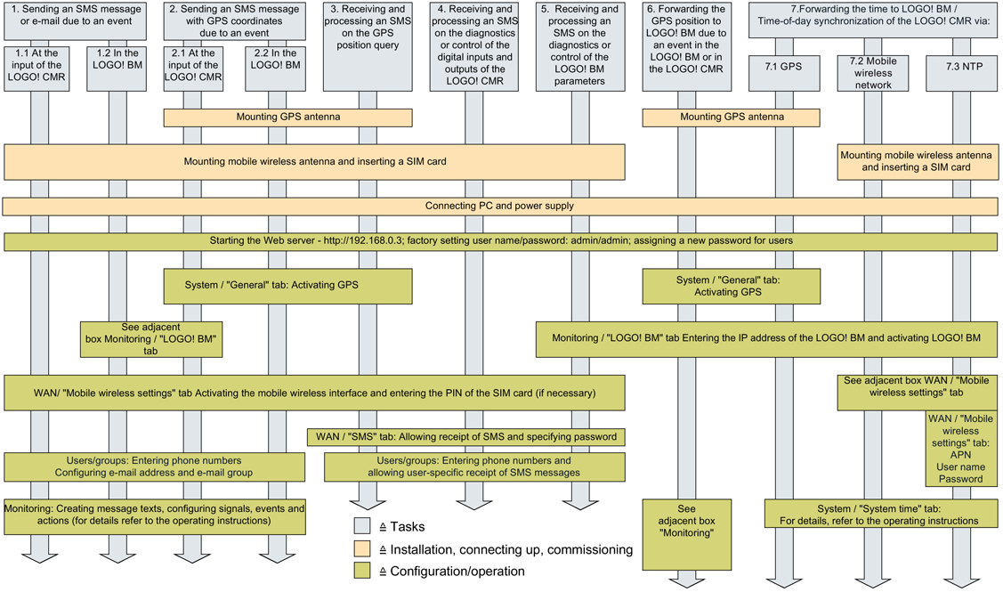
Commissioning LOGO! CMR
First steps
What to do ?
Hardware installation
Web Interface
See also included product information and manual

Slide 32
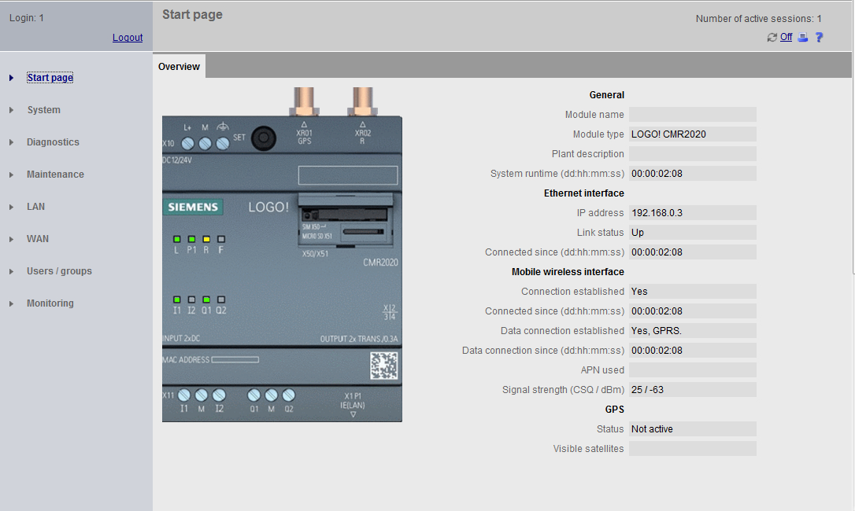
Configuration with web based management
Start page

Slide 33
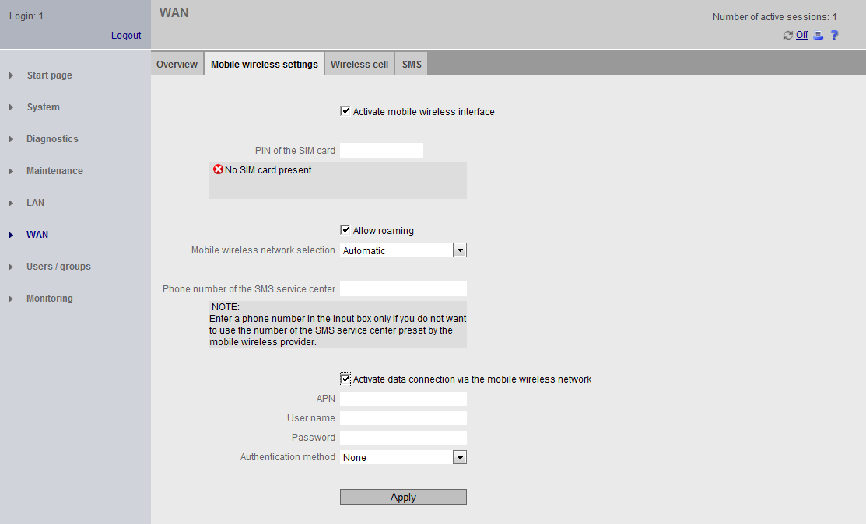
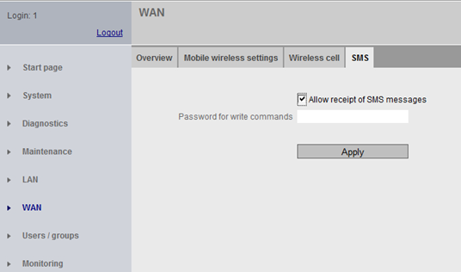
Configuration with web based management
Mobile wireless settings
Password
SIM-Card
Password Received SMS

Slide 34
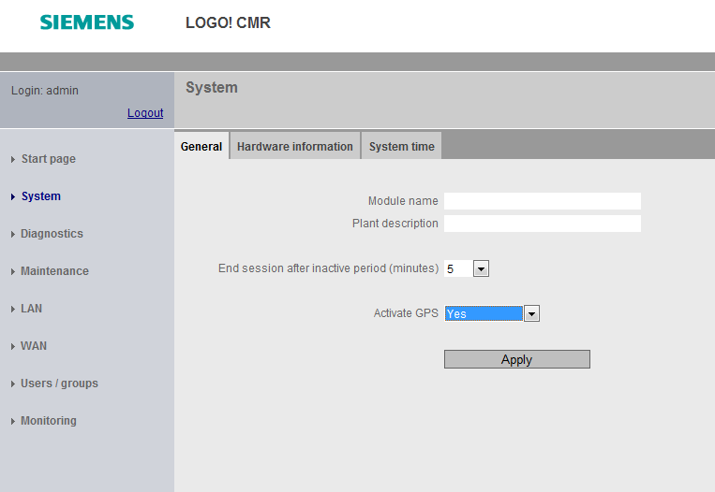
Configuration with web based management
Activate GPS
Activate GPS

Slide 35
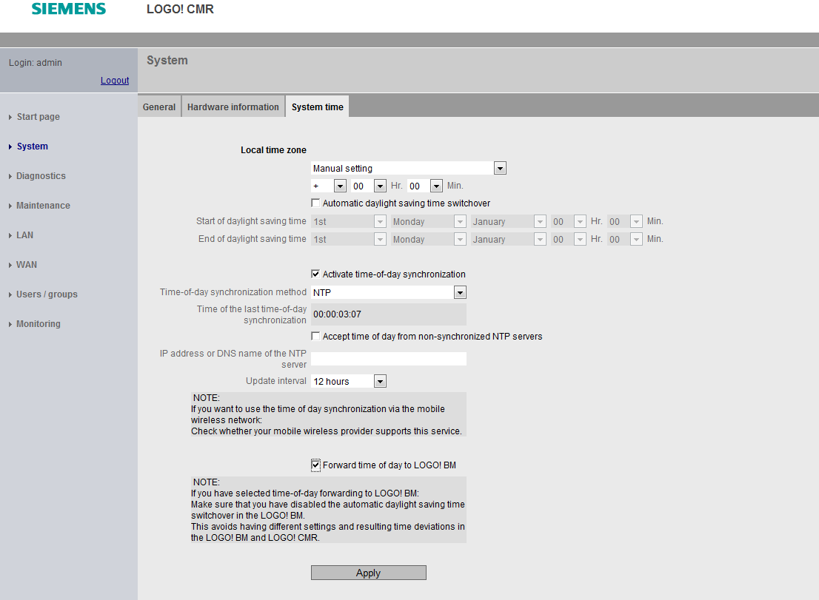
Configuration with web based management
Time-of-day synchronization
Options:
NTP
GPS
Cellular network provider
For NTP only,
Input address of NTP Server
Activate drop down menu “Activate data connection via the mobile wireless network” at register “Mobile wireless settings”
Options Update Interval:
1 hour
12 hours
1 day
For GPS only
Activate “drop down menu „Activate GPS“ at register ”System”
Forward to
LOGO! BM

Slide 36
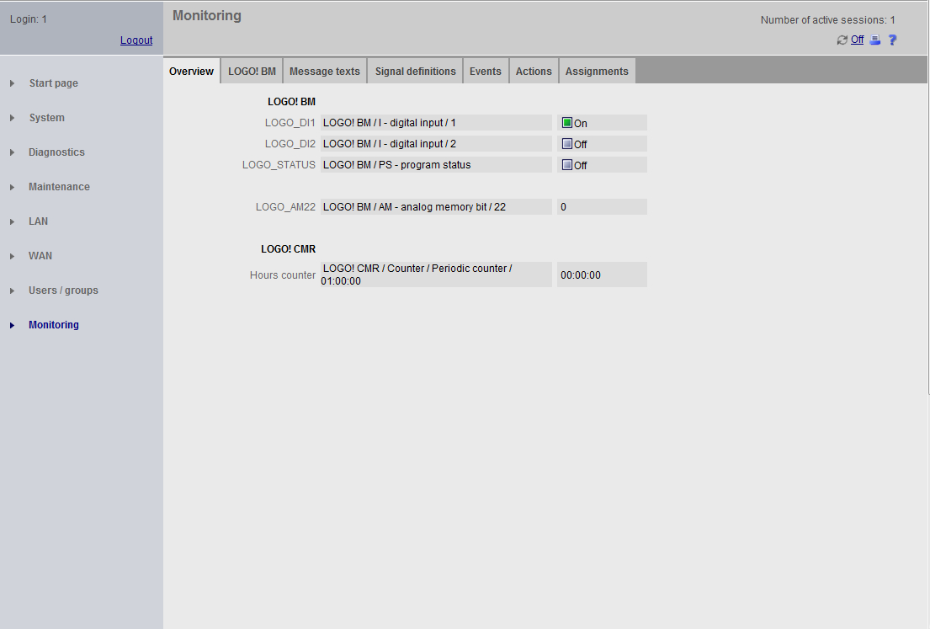
Configuration with web based management
Signal monitoring

Slide 37
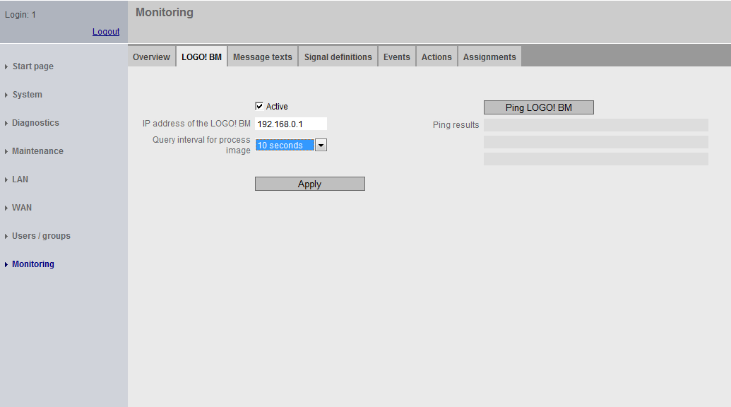
Configuration with web based management
Example
  A water tank holds 100 liters. If the volume of 100 liters is exceeded, an alarm message will be sent to the maintenance staff (SMS message).
  The maintenance staff consists of two employees, employee "User-1" and employee "User-2" whose phone numbers are known. The employees are organized in a group called „Maintenance Staff“
  A fill level sensor is connected to input no. 1 of the LOGO! BM: If the measurement indicates that the amount of liquid has been exceeded (> 100 liters in the tank), the fill level sensor sets digital input no. 1 to "1".
Activate
Connection to LOGO! BM

Slide 38
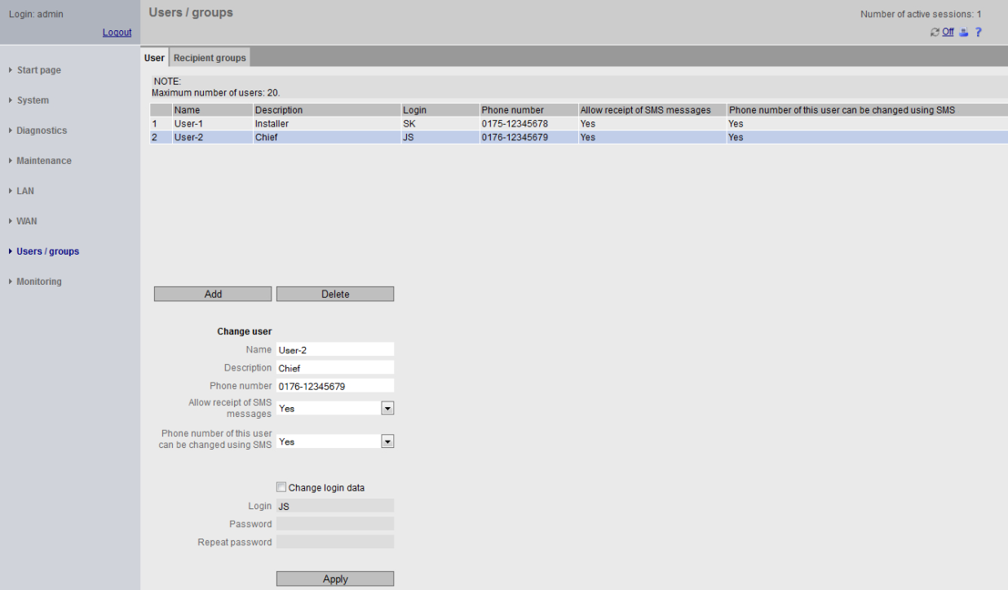
Configuration with web based management
Create user
  A water tank holds 100 liters. If the volume of 100 liters is exceeded, an alarm message will be sent to the maintenance staff (SMS message).
  The maintenance staff consists of two employees, employee "User-1" and employee "User-2" whose phone numbers are known. The employees are organized in a group called „Maintenance Staff“
  A fill level sensor is connected to input no. 1 of the LOGO! BM: If the measurement indicates that the amount of liquid has been exceeded (> 100 liters in the tank), the fill level sensor sets digital input no. 1 to "1".

Slide 39
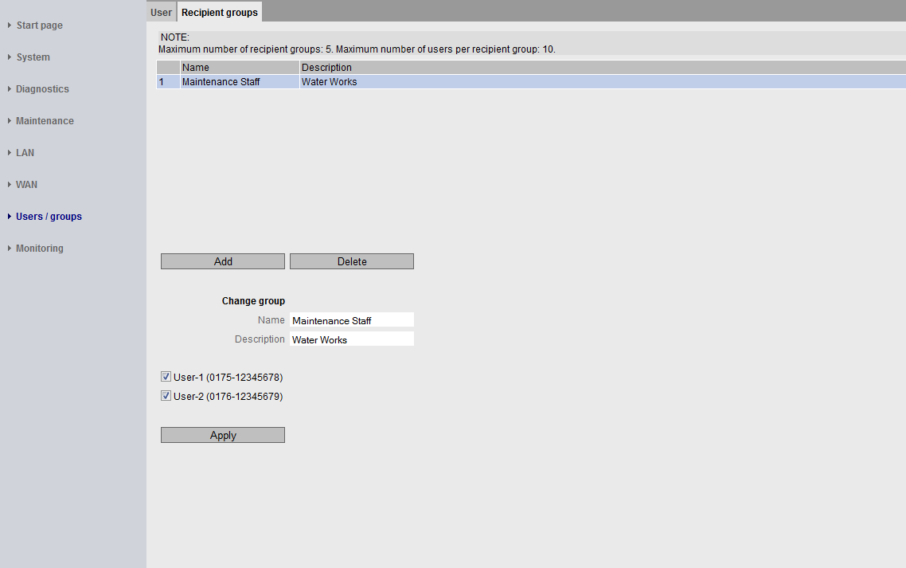
Configuration with web based management
Create user group
  A water tank holds 100 liters. If the volume of 100 liters is exceeded, an alarm message will be sent to the maintenance staff (SMS message).
  The maintenance staff consists of two employees, employee "User-1" and employee "User-2" whose phone numbers are known. The employees are organized in a group called „Maintenance Staff“
  A fill level sensor is connected to input no. 1 of the LOGO! BM: If the measurement indicates that the amount of liquid has been exceeded (> 100 liters in the tank), the fill level sensor sets digital input no. 1 to "1".

Slide 40
Configuration with web based management
Monitoring-/message configuration in 5 steps
Message texts
Signal definitions
Define possible SMS message texts
2. Define signals, that the CMR can use
Actions
Events
4. Define possible actions
Possible actions:
Send SMS
Set CMR output
Start / Stop Basismodul
3. Define activation events
Possible events:
Basismodul-variable change
CMR-input change
Timer expiration
Requirement for / Assignments
5. Which event activates which action?

Slide 41
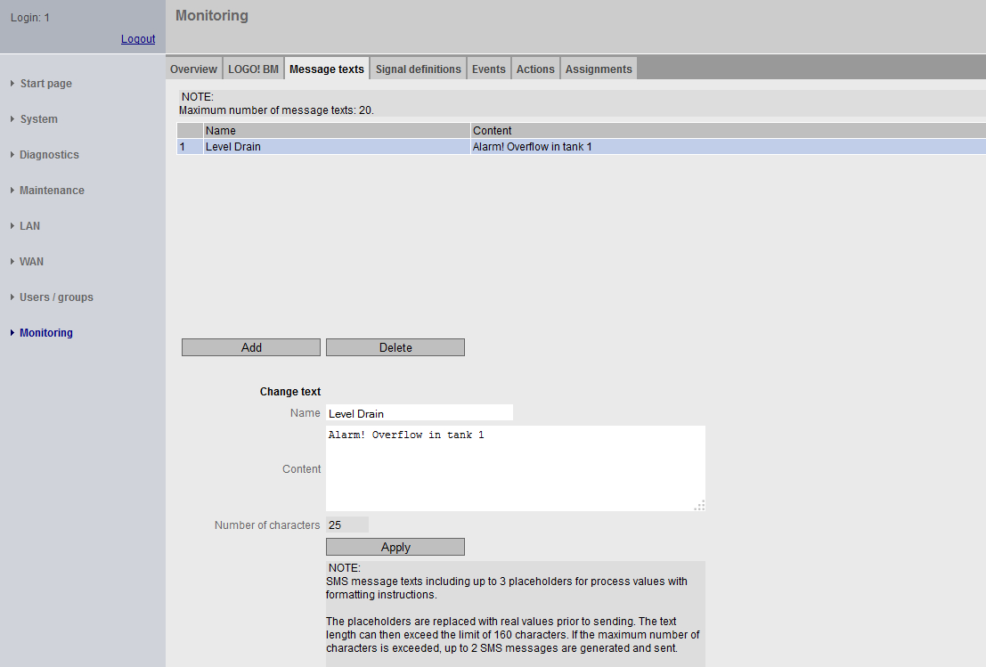
Monitoring-/message configuration
1. Define message text
  A water tank holds 100 liters. If the volume of 100 liters is exceeded, an alarm message will be sent to the maintenance staff in form of an SMS message.
  The maintenance staff consists of two employees, employee "User-1" and employee "User-2" whose phone numbers are known. The employees are organized in a group called „Maintenance Staff“
  A fill level sensor is connected to input no. 1 of the LOGO! BM: If the measurement indicates that the amount of liquid has been exceeded (> 100 liters in the tank), the fill level sensor sets digital input no. 1 to "1".

Slide 42
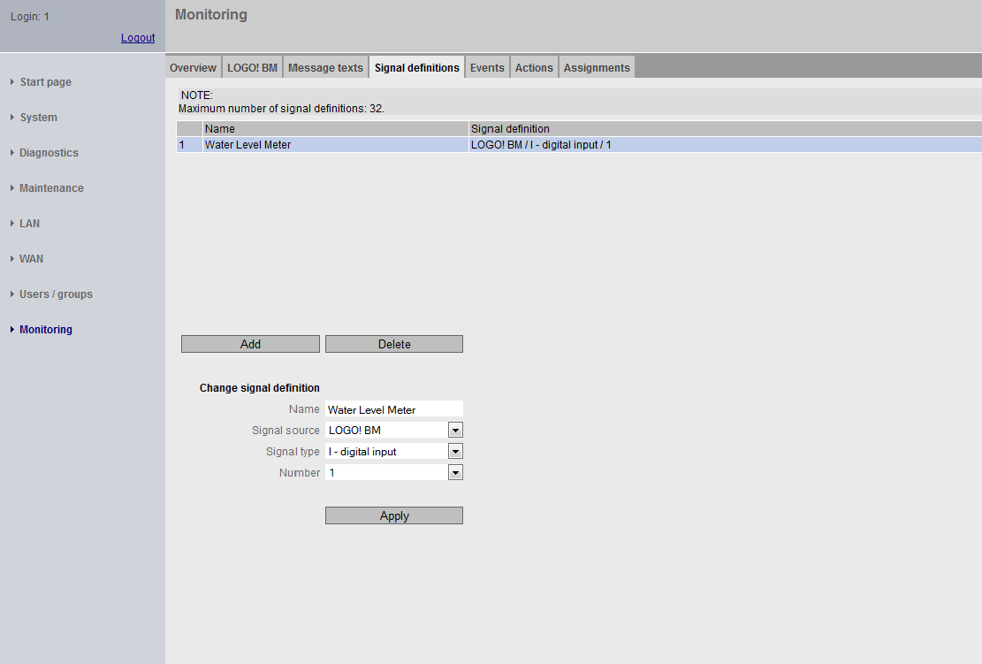
Monitoring-/message configuration
2. Define signal
  A water tank holds 100 liters. If the volume of 100 liters is exceeded, an alarm message will be sent to the maintenance staff in form of an SMS message.
  The maintenance staff consists of two employees, employee "User-1" and employee "User-2" whose phone numbers are known. The employees are organized in a group called „Maintenance Staff“
  A fill level sensor is connected to input no. 1 of the LOGO! BM: If the measurement indicates that the amount of liquid has been exceeded (> 100 liters in the tank), the fill level sensor sets digital input no. 1 to "1".

Slide 43
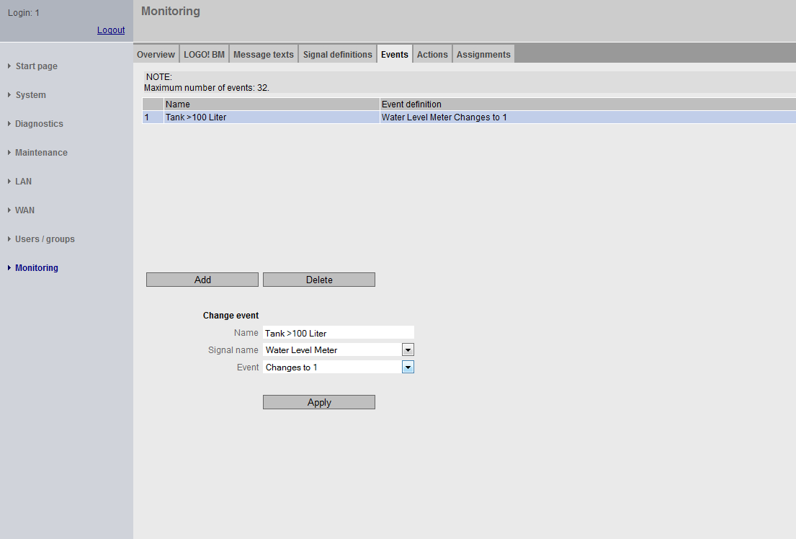
Monitoring-/message configuration
3. Define events
  A water tank holds 100 liters. If the volume of 100 liters is exceeded, an alarm message will be sent to the maintenance staff in form of an SMS message.
  The maintenance staff consists of two employees, employee "User-1" and employee "User-2" whose phone numbers are known. The employees are organized in a group called „Maintenance Staff“
  A fill level sensor is connected to input no. 1 of the LOGO! BM: If the measurement indicates that the amount of liquid has been exceeded (> 100 liters in the tank), the fill level sensor sets digital input
  no. 1 to "1“.

Slide 44
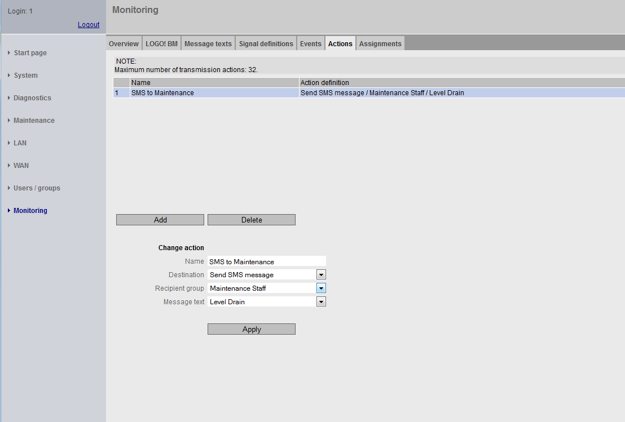

Monitoring-/message configuration
4. Define action e.g. SMS
  A water tank holds 100 liters. If the volume of 100 liters is exceeded, an alarm message will be sent to the maintenance staff in form of an SMS or e-mail message.
  The maintenance staff consists of two employees, employee "User-1" and employee "User-2" whose phone numbers are known. The employees are organized in a group called „Maintenance Staff“
  A fill level sensor is connected to input no. 1 of the LOGO! BM: If the measurement indicates that the amount of liquid has been exceeded (> 100 liters in the tank), the fill level sensor sets digital input no. 1 to "1".
Information of the action e.g. SMS or e-mail senden
and Selection „Action“ to LOGO! CMR or LOGO! BM
Depending on which action was selected the other fields will appear/ disappear, e.g. for the specification of the message text

Slide 45
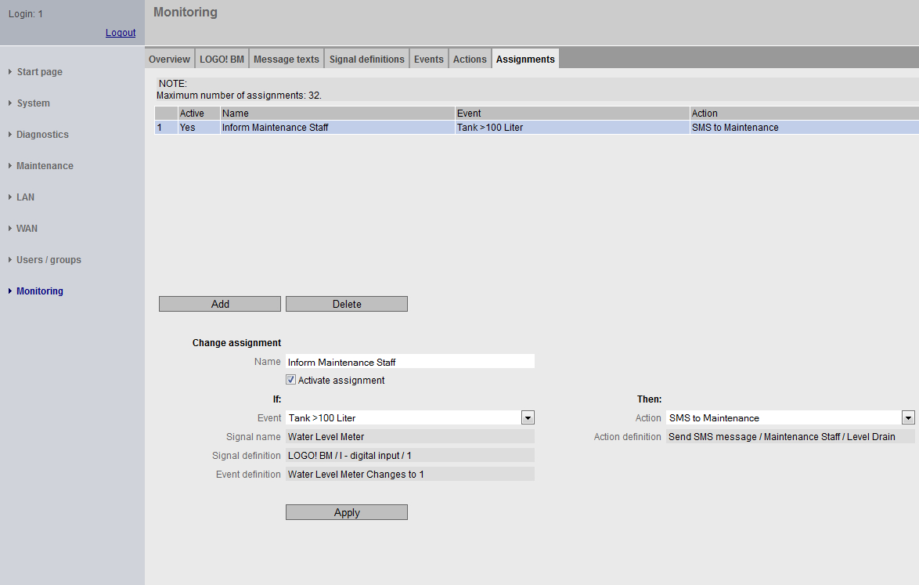
Monitoring-/message configuration
5. Define assignments: event to action
  A water tank holds 100 liters. If the volume of 100 liters is exceeded, an alarm message will be sent to the maintenance staff in form of an SMS message.
  The maintenance staff consists of two employees, employee "User-1" and employee "User-2" whose phone numbers are known. The employees are organized in a group called „Maintenance Staff“
  A fill level sensor is connected to input no. 1 of the LOGO! BM: If the measurement indicates that the amount of liquid has been exceeded (> 100 liters in the tank), the fill level sensor sets digital input no. 1 to "1".
If (Event due to signal)
Then
(Action e.g. send messagetext)

Slide 46
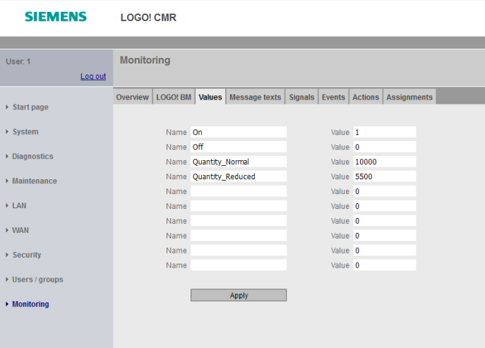
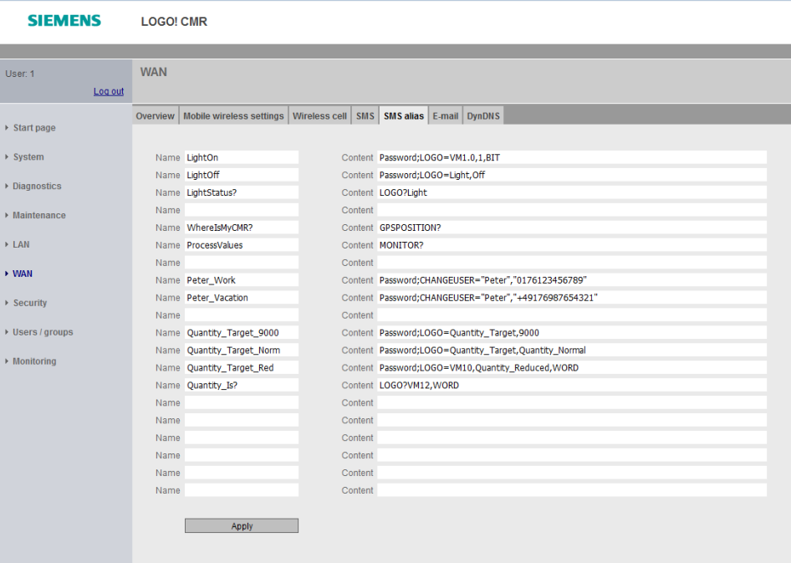
Configuration via web based management
Alias-SMS – <WAN> <SMS – Alias>
„SMS-Alias“ – Input of an intuitive command, this will be used in this syntax on the mobile phone
e.g. LightOn
SMS-Syntax“ – Input of the LOGO! CMR interpretable SMS-Syntax e.g. Passwort;LOGO=VM125,1,WORD

Slide 47
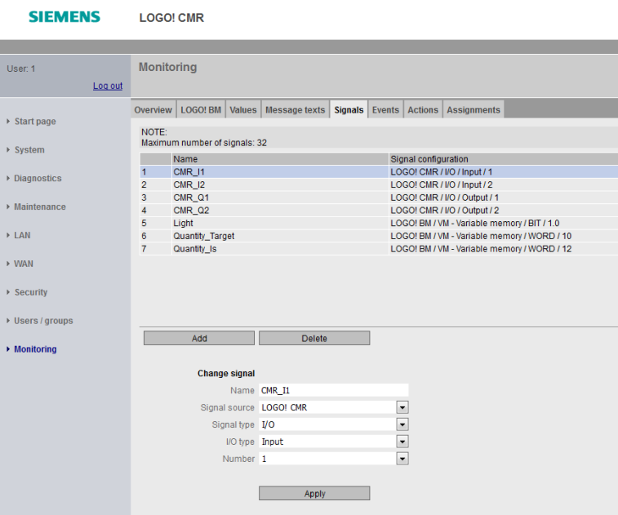
Configuration via web based management
Symbolic name in SMS-syntax
Symbolic value name
Change/ read data at CMR/LOGO! BM | Example Syntax SMS-Befehl | New with symbolic tag name | Example for Alias SMS
Write current value | Password;LOGO=VM125,1,Byte | Password;LOGO=Light,1 | LightOn
Set DI Output CMR | Password;OUTPUT=O1,0 | Password;OUTPUT=CMR_Q1, 0 | Gate1 close
Read current value | LOGO?VM125,WORD | LOGO?Quantity_Target | Level1

Slide 48
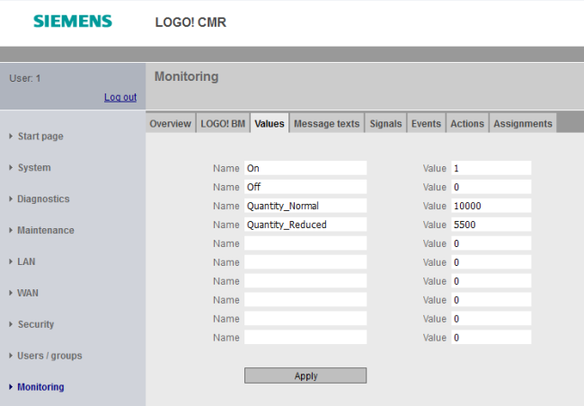
Configuration via web based management
Symbolic name in SMS-syntax
Symbolic name / constants
Change read/ write CMR/LOGO! BM | Example Syntax SMS-Befehl | New with symbolic tagname | Example for SMS-Alias
Write current value | Password;LOGO=VM125,dynWert,BYTE | Password;LOGO=VM125, Quantity_Normal, Byte Quantity_Normal is defined as a signal in the signal definition and is as supplied by a value of the LOGO! BM | Temperatur change
Set Digital Output CMR | Passwort;OUTPUT=O1,dynWert | Password;OUTPUT=O1, OFF | Gate1 close

Slide 49
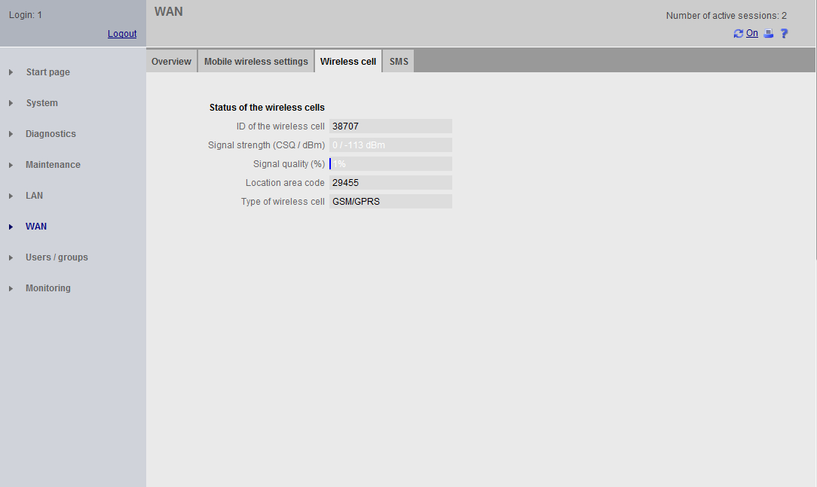
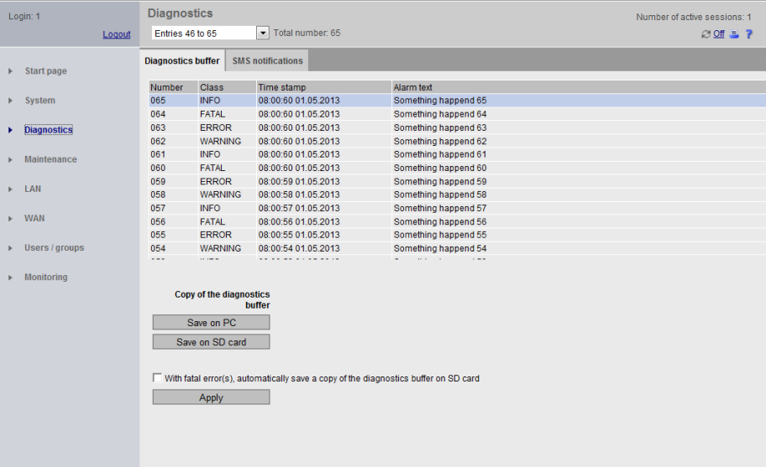
LOGO! CMR diagnostics
Wireless cell
Diagnostic buffer
…

Slide 50
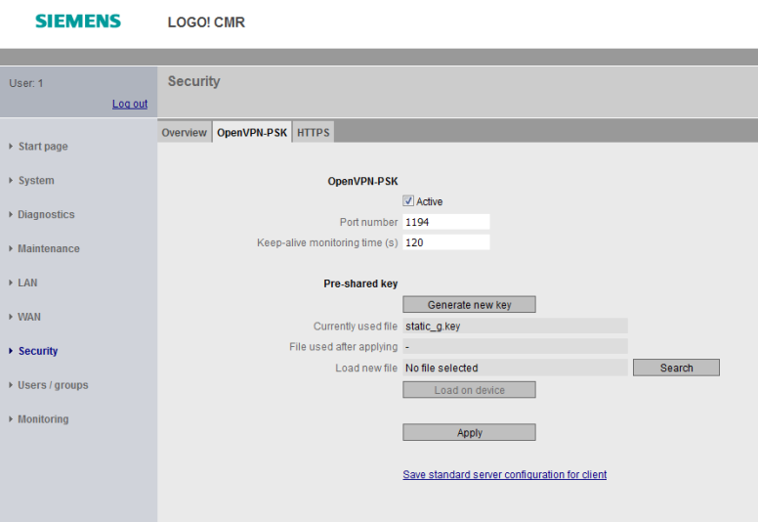
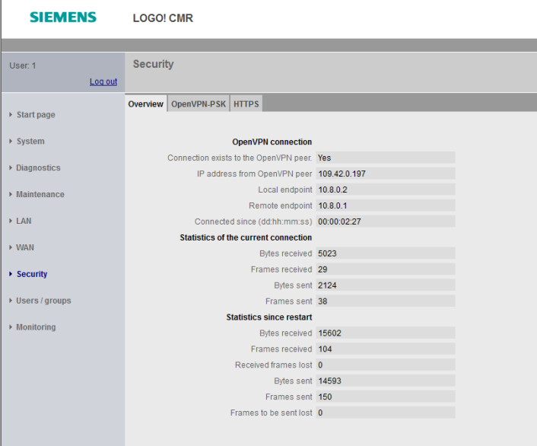
Remote access connection to LOGO! BM
Security settings OpenVPN
If the Pre-shared Key should be generated at CMR, it could be started via this Button.
If the Pre-shared Key should be generated at the partner (OpenVPN-Client), the file could be imported here.

Slide 51

LOGO! CSM
Design
Terminals for power supply
LOGO! Design
Switch for junction box (4TE) with one Ethernet Port on the front
Diagnostics-LEDs for
  supply voltage
  Link status and data transfer per port
Industrial Ethernet port e.g. for configuration and diagnostics, also accessible in the junction box without opening the cover 1 Port RJ45
  100 Mbit/s with auto sensing and auto crossover functionality
Industrial Ethernet connection
  3 Ports RJ45
  100 Mbit/s with auto sensing and auto crossover functionality
Mounting Options:
  Mounting rails (35mm according to DIN EN 50022)
  Wall Mounting

Slide 52
Agenda
1
Positioning
2
Technology / portfolio
3
Benefits
4
Use Cases
5
Technical Details
6
Order information and logistic
7
Target customers
8
Support

Slide 53
LOGO!
Ordering data
Simply brilliant for small automation tasks
Logic module LOGO!
You can find the current version of the brochure on the Internet
Click here:

Slide 54
LOGO! Communication modules
Ordering data
Device | MLFB | Description
LOGO! CMR2020 | 6GK7142-7BX00-0AX0 | LOGO! CMR2020 communication module for connection LOGO! 8 to GSM/GPRS network; 1 RJ45 port for Ind. Ethernet connection to LOGO! 8; 2xDI; 2xDQ; Write/read access to LOGO! tags; Text message sending/ receipt; E-mail sending; Position detection GPS; Time synchronization/ forwarding with real-time clock; Configuration/diagnostics via web interface; Remote access via OpenVPN/HTTPs, DynDNS; Observe national approval! Manual available as a download
LOGO! CMR2040 | 6GK7142-7EX00-0AX0 | LOGO! CMR2040 communication module for connection LOGO! 8 to LTE network; 1 RJ45 port for Ind. Ethernet connection to LOGO! 8; 2xDI; 2xDQ; Write/read access to LOGO! tags; Text message sending/ receipt; E-mail sending; Position detection GPS; Time synchronization/ forwarding with real-time clock; Configuration/diagnostics via web interface; Remote access via OpenVPN/HTTPs, DynDNS, observe national approval! Manual available as a download
LOGO! CSM12/24 | 6GK7177-1MA20-0AA0 | LOGO! CSM12/24 Compact Switch Module connection of a LOGO! (. ..0BA7/...0BA8) and up to 3 further nodes to Ind. Ethernet with 10/100 Mbit/s Unmanaged switch, 4 RJ45 ports, 1x front port for diagnostics DC 12/24V power supply LED diagnostics, LOGO! setup

Slide 55

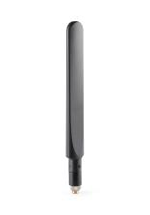
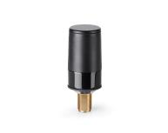

LOGO! CMR
Ordering data Accessories 1
Mobile Wireless Antenna:
ANT794-4MR (6NH9860-1AA00) ANT794-4MR mobile wireless antenna for 2G/3G/4G EU, GSM/UMTS/ LTE EU networks, Rod antenna; omnidirectional; weatherproof for indoors and outdoors; 5 m Connection cable permanently connected to the antenna; SMA connector; incl. mounting bracket, screws, screw anchor
ANT896-4MA (6GK5896-4MA00-0AA3) ANT896-4MA mobile wireless antenna for GSM (2G), UMTS (3G) and LTE(4G) networks; Omnidirectional Characteristic, Radially rotatable, with additional joint, Antenna gain: 2 dBi, incl. SMA connector, IP54, (-40-+85°C), Observe national approvals; for direct installation with SMA connection system scope of delivery: 1x ANT 896-4MA, compact instructions as hard copy German/English
ANT896-4ME (6GK5896-4ME00-0AA0) ANT896-4ME mobile wireless antenna for GSM (2G), UMTS (3G) and LTE(4G) Networks, Omnidirectional Characteristic, incl. N-female connector: 3 dBi; IP66 (-40-+70°C), Observe national approvals; mounting on control cabinet; scope of delivery: 1x ANT 896-4ME, compact instructions as hard copy English/German
GPS Antenna:
ANT895-6ML (6GK5895-6ML00-0AA0) ANT895-6ML GPS antenna Antenna with integrated signal amplifier incl. 0.3 m connection cable and N-female connector; 3 dBi IP67 (-40...+85 °C) Mounting with magnet or Screw mounting Observe national approvals; compact instructions as hard copy English/German; scope of delivery: 1x ANT 895-6ML

Slide 56




LOGO! CMR
Ordering data Accessories (2)
Connecting Cable:
SIMATIC NET N-CONNECT/SMA MALE/MALE FLEXIBLE CONNECTION CABLE pre-assembled suitable for 0..6 GHz, IP68 Lengths: 6XV1875-5LE30 0,3m 6XV1875-5LH10 1m 6XV1875-5LH20 2m 6XV1875-5LH50 5m
SIMATIC NET N-CONNECT MALE/MALE FLEXIBLE CONNECTION CABLE pre-assembled; suitable for 0..6 GHz, IP68 Lengths: 6XV1875-5AH10 1m 6XV1875-5AH20 2m 6XV1875-5AH50 5m 6XV1875-5AN10 10m
Control Panel Feed Through:
PANEL FEEDTHROUGH (6GK5798-2PP00-2AA6) N-Connect Female/female Panel feedthrough, cabinet bushing, 2.4 GHz and 5 GHz for Wall thickness max. 4.5 mm
Lightning protector LP 798-1N (6GK5798-2LP00-2AA6) Lightning protection element with N/N female/female connection, IP66/68 (-40 °C...+85 °c), 0...6 ghz, with gas discharge technology for scalance w and m antennas, compact instructions as hard copy german/english

Slide 57


Connecting the antennas to the LOGO! CMR
Configuration with GPS und cellular network
LOGO! CMR with Remote Antennas
LOGO! CMR: directly connected Cellular Network Antennas

Slide 58
Connecting the antennas to the LOGO! CMR in the control cabinet – configuration with GPS und cellular network
LOGO! CMR with Panel Feed Through
LOGO! CMR with Panel Feed Through incl. Lightning Protect

Slide 59
Agenda
1
Positioning
2
Technology / portfolio
3
Benefits
4
Use Cases
5
Technical Details
6
Order information and logistic
7
Target customers
8
Support

Slide 60





Typical application areas
  Simple remote monitoring and remote control tasks (also in domestic applications such as heating control, window control, garden watering)
  Building automation including building equipment for HVAC and pump control, for example
  Irrigation, automatic feeders in agriculture
  Remote control and monitoring of low-end machine control (usually discrete logic)
  Remote control and monitoring of level, pressure, temperature and flow, and valve control in the water/wastewater industry
  Position monitoring in the logistics field (e.g. vehicles, refrigerated transporters, containers)
  Basic energy monitoring

Slide 61
Agenda
1
Positioning
2
Technology / portfolio
3
Benefits
4
Use Cases
5
Technical Details
6
Order information and logistic
7
Target customers
8
Support

Slide 62


Further information
  Further information on the logic module LOGO! unter:
  siemens.com/logo
  Movie about LOGO!
  Brochure LOGO!

Slide 63

Thank you for your attention!
Subject to changes and errors. The information given in this document only contains general descriptions and/or performance features which may
not always specifically reflect those described, or which may undergo modification in the course of further development of the products. The requested performance features are binding only when they are expressly agreed upon in the concluded contract.
All product designations, product names, etc. may contain trademarks or other rights of Siemens AG, its affiliated companies or third parties.
Their unauthorized use may infringe the rights of the respective owner
siemens.com/logo

Slide 64
Disclaimer
Subject to changes and errors. The information given in this document only contains general descriptions and/or performance features which may not always specifically reflect those described, or which may undergo modification in the course of further development of the products. The requested performance features are binding only when they are expressly agreed upon in the concluded contract.
All product designations, product names, etc. may contain trademarks or other rights of Siemens AG, its affiliated companies or third parties. Their unauthorized use may infringe the rights of the respective owner.

Slide 65
Security information
      Siemens provides products and solutions with industrial security functions that support the secure operation of plants, systems, machines and networks.
      In order to protect plants, systems, machines and networks against cyber threats, it is necessary to implement – and continuously maintain – a holistic, state-of-the-art industrial security concept. Siemens’ products and solutions constitute one element of such a concept.
      Customers are responsible for preventing unauthorized access to their plants, systems, machines and networks. Such systems, machines and components should only be connected to an enterprise network or the internet if and to the extent such a connection is necessary and only when appropriate security measures (e.g. firewalls and/or network segmentation) are in place.
      For additional information on industrial security measures that may be implemented, please visit https://www.siemens.com/industrialsecurity.
      Siemens’ products and solutions undergo continuous development to make them more secure. Siemens strongly recommends that product updates are applied as soon as they are available and that the latest product versions are used. Use of product versions that are no longer supported, and failure to apply the latest updates may increase customer’s exposure to cyber threats.
      To stay informed about product updates, subscribe to the Siemens Industrial Security RSS Feed under https://www.siemens.com/industrialsecurity.

